Slide 1
Morning Joe’s Coffee
An Exploration into Similar Communities in Scarborough

Slide 2
Business Problem
Morning Joe’s is a coffee shop in Toronto
They serve a particular client and have surveyed their clients
They are looking to move into the Scarborough area
Aren’t sure where but want a similar are with similar shops

Slide 3
Data
Data pulled from a survey that highlights what constitutes a similar area
Data pulled from Geocoder highlights the information of the neighborhoods within Scarborough
Venue information pulled from FourSquare

Slide 4
Discovery
Using the specific set of criteria, the top neighborhood was
Dorset Park, Scarborough Town Centre, Wexford
However, a backup was discovered just in case
Agincourt
The difference in the locations revolves around the venues
The Town Centre is mostly shopping
Agincourt is more of an activity centre

Slide 5
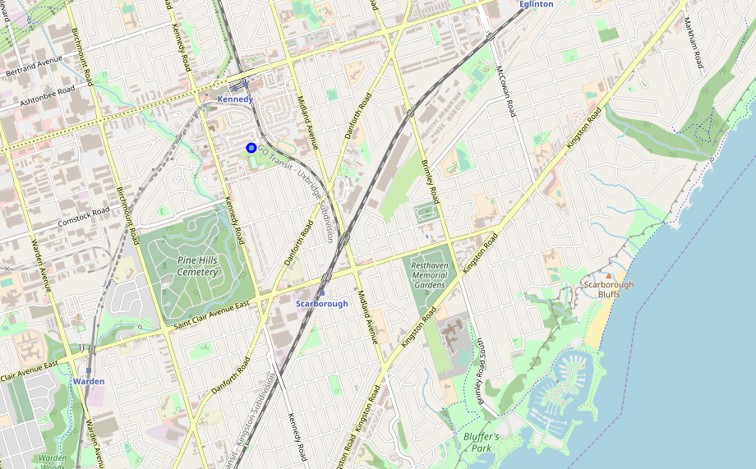
Map Result

